Slide 1

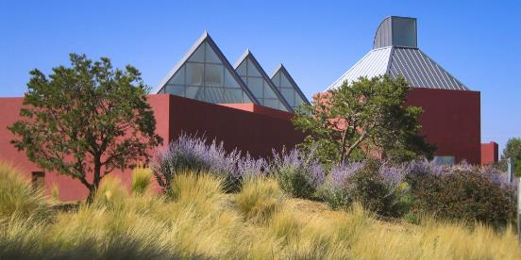
Progress Report
August 17, 2022

Slide 2
PLANNING & PREDEVELOPMENT ACTIONS
City creates redevelopment plans for Midtown
Rezone site (Land Development Plan)
Plan for infrastructure – (Assessments)
Prepare site and buildings for reuse and redevelopment
Reuse existing buildings for community purposes (RFPs)
Promote Garson Studies Lot (RFP)
Identify parcels for mixed-income and affordable housing development (Phase 1 and Land Development Plan)
Assess and establish public funding mechanisms (Economic model in progress)
Engage the public for development planning (Land and Community Development Plan)
(Memo to Governing Body, from Rich Brown, Director of Community & Economic Development, dated March 26, 2021)

Slide 3
MIDTOWN REDEVELOPMENT PLANS
PLANNING PHASE
IMPLEMENTATION
July – December 2021
January – June 2022
July – November 2022
2022 – Years Ahead
LAND DEVELOPMENT PLAN
Planning Session: Listening
Planning Session: Workshop
Draft Plan & Presentations
Early Neighborhood Notification
Public Hearings & Approvals
DEVELOPMENT
COMMUNITY DEVELOPMENT PLAN
Public Engagement Events
Public Engagement Report
Draft Plan & Presentations
Public Hearings & Approvals

Slide 4
MIDTOWN REDEVELOPMENT PLANS
PLANNING PHASE
IMPLEMENTATION
July – December 2021
January – June 2022
July – October 2022
2022 – Years Ahead
BUILDS ON MANY YEARS OF PLANNING EFFORTS
+ 2016 MIDTOWN LINC OVERLAY
+ 2018 MIDTOWN CAMPUS PROJECT - MIDTOWN PLANNING GUIDELINES
+. 2021 MIDTOWN PLANNING SESSIONS
+. 2021-2022 MIDTOWN ENGAGEMENT PARTNERS - REPORT
+. Hundreds of emails and calls City receives from civic organizations and residents
LAND DEVELOPMENT PLAN
Planning Session: Listening
Planning Session: Workshop
Draft Plan & Presentations
Early Neighborhood Notification
Public Hearings & Approvals
DEVELOPMENT
COMMUNITY DEVELOPMENT PLAN
Public Engagement Events
Public Engagement Report
Draft Plan & Presentations
Public Hearings & Approvals

Slide 5
Two Interconnected Plans to be Approved
…the City is leading a team of planning and public engagement consultants to create two inter-connected plans that will be combined to create the Midtown Redevelopment Plan. The Governing Body will vote on these plans.
LAND DEVELOPMENT PLAN: lays out land uses and infrastructure framework to enable future development and investment.
COMMUNITY DEVELOPMENT PLAN: identifies community goals and benefits that will be delivered as development is implemented.
These inter-connected plans will guide the City and allow for- and non- profit developers to implement development incrementally over time to achieve community goals

Slide 6
Land Development Plan Update
JULY 14: Early Neighborhood Notification (ENN) Meeting
AUGUST 8 ENN Public Questions Answered and Posted
AUGUST 15 Land Development Plan Posted
AUGUST 22 Land Use Plan Application Due
OCTOBER 6 Planning Commission Hearing
NOVEMBER 9 Governing Body Hearing
Midtown Redevelopment Plans

Slide 7
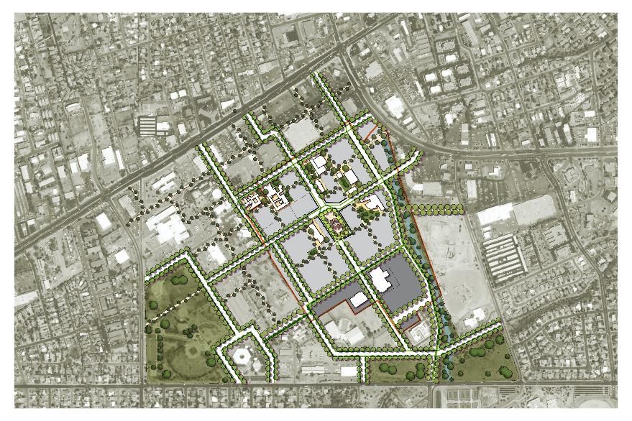
Midtown District Master Plan

Slide 8
Land Development Plan: Master Plan & Zoning
Why? It regulates land uses
Master Plan is necessary to create the framework for development to occur within streets, blocks, parcels, along with the infrastructure to support the redevelopment of the site.
Midtown Master Plan is not prescriptive and allows for the flexibility for incremental so that the City and public can respond to development markets and public policy as the site is developed over time.
Master Plan
Creates the network of streets and blocks where development is allowed to occur, as well as open space for recreation and green infrastructure.
Parcels and blocks may be disposed of for master developers, as well as small- and medium- sized development firms can participate in the development of Midtown
Establishes design guidelines to create a cohesive sense of place unique to the center of Santa Fe.
Provides a framework where primary uses may be developed – residential, office, educational, retail, film.

Slide 9
Community Development Plan
Why? It establishes policy
Through the public engagement effort, people envisioned more than land use goals and design standards for the redevelopment of Midtown.
People voiced community and public objectives for the redevelopment of Midtown.
The Midtown Community Development Plan puts policy into action as development plans are implemented.
Sustainable and Equitable Development
Four Pillars of Sustainable Development
  Equity
  Environment
  Economic
  Culture
Requirements and priorities for development will be established in the Community Development Plan and will be incorporated in RFPs as land and buildings are sold or leased.
Developers and Owners will be required to adhere to policies set forth in the Community Development Plan through Development and Disposition Agreements.

Slide 10
Community Development Plan
Why? It establishes policy
Through the public engagement effort, people envisioned more than land use goals and design standards for the redevelopment of Midtown.
People voiced community and public objectives for the redevelopment of Midtown.
The Midtown Community Development Plan puts policy into action as development plans are implemented.
Sustainable and Equitable Development
Four Pillars of Sustainable Development
  Equity
  Environment
  Economic
  Culture
Requirements and priorities for development will be established in the Community Development Plan and will be incorporated in RFPs as land and buildings are sold or leased.
Developers and Owners will be required to adhere to policies set forth in the Community Development Plan through Development and Disposition Agreements.

Slide 11
Community Development Plan
EQUITY
COMMUNITY DEVELOPMENT
Promote, Support, and Facilitate community health, stability, and well being
Housing Affordability
Housing Choices
Housing needs and priorities
Types of tenure – ownership, rental, land trust
Building Capacity
Develop local capacity for community-based approaches to housing and neighborhood development
Neighborhood Stabilization
Anti-Displacement
Neighborhood Stabilization Plan (adjacent neighborhoods – city commitment)
Development without Displacement Overlay District - acknowledge and address impacts of development on adjacent low-income neighborhood

Slide 12
Community Development Plan
ENVIRONMENT
LAND DEVELOPMENT
Acknowledge land and water, implement best practices for site regeneration and resiliency, base land development plans on the USGBC LEED: Neighborhood Development program.
Infrastructure
Site resiliency and regeneration
Water management – retention and detention
Street Designs and Biophilia (connecting people to nature)
Street and Block Networks
Circulation and Connectivity
Mobility – Multi-Modal
Open Space and District-Wide Connectivity
Density
Land uses and areas/ zones
Memory of Place / Land Acknowledgement
District Area – Connectivity & Mobility
LINC
Access and Connectivity
Adjacent neighborhoods
Adjacent commercial zone
Environmental Design
Healthy District / Inclusive Design
Green Building and Regenerative Site Design

Slide 13
Community Development Plan
ENVIRONMENT
LAND DEVELOPMENT
Acknowledge land and water, implement best practices for site regeneration and resiliency, base land development plans on the USGBC LEED: Neighborhood Development program.
Land Uses – Mixed Use District
Residential
Housing Types and Choices
Affordable housing parcels (early start)
Inclusionary zoning
Commercial
Film and multi-media
Technology
Arts & Culture
Entrepreneurialism
Open Space
Public Gathering
Parks and Parklets
Town Center Plaza
Existing Buildings
Reused Buildings: community uses (arts, culture, performance and entertainment, library/ learning, film)
Substandard Buildings: to be demolished
Other Buildings: temporary and potential long term uses identified through RFPs or civic uses

Slide 14
Community Development Plan
ECONOMY
ECONOMIC DEVELOPMENT
Create opportunities to stabilize communities, promote good jobs, and facilitate community economic development
Job Creation
RFPs to promote jobs for local residents in film and multimedia, arts and entertainment, technology
Job Training and Career Education
Internships
Trades and Vocational Training
Career Education
Job Access
Centralize job opportunities and information
Economic Development
Development and Zoning linkages to achieve community development objectives that require subsidy and/or developer incentives

Slide 15
Community Development Plan
ECONOMY
ECONOMIC DEVELOPMENT
Create opportunities to stabilize communities, promote good jobs, and facilitate community economic development
Entrepreneurialism
Local small businesses
Commercial space affordability
Live & Work
Live/Work development
Increased connection and walkability between work and home
Community Resources
RFPs to facilitate development of childcare, senior, afterschool, learning labs, health centers to address barriers to work

Slide 16
Community Development Plan
CULTURE
MEMORY OF PLACE
Promote arts and culture, facilitate community planning, support district programming, acknowledge land
Community Arts Stabilization
RFP for Visual Arts Center for Arts Hub
Arts & Cultural Placemaking and Pllacekeeping
Public programming for local interests
Relocate existing sculpture
Plazas and open space to accommodate wide range of community events
Public Space, Programming, & Uses
Identify source and entity to manage public programming and uses of public spaces that focuses on local communities and cultures
Preserve and Enhance Memory of Place
Reuse certain existing buildings for civic uses that facilitate community interaction in public spaces
District Planning & Governance
Inclusive Civic Engagement
Pursue Metropolitan Redevelopment Area (MRA) to establish a governance and planning structure

Slide 17
Community Development Plan Update
AUGUST 15 Community Development Plan Posted
AUGUST 17 Quality of Life Presentation
AUGUST 31 Governing Body Presentation (Progress Report)
SEPTEMBER 15 Planning Commission Presentation
SEPTEMBER 28 Governing Body Presentation (Progress Report)
OCTOBER 12 Economic Development Advisory Committee
OCTOBER 17 Finance Committee
NOVEMBER 9 Governing Body Hearing
Midtown Redevelopment Plans

Slide 18
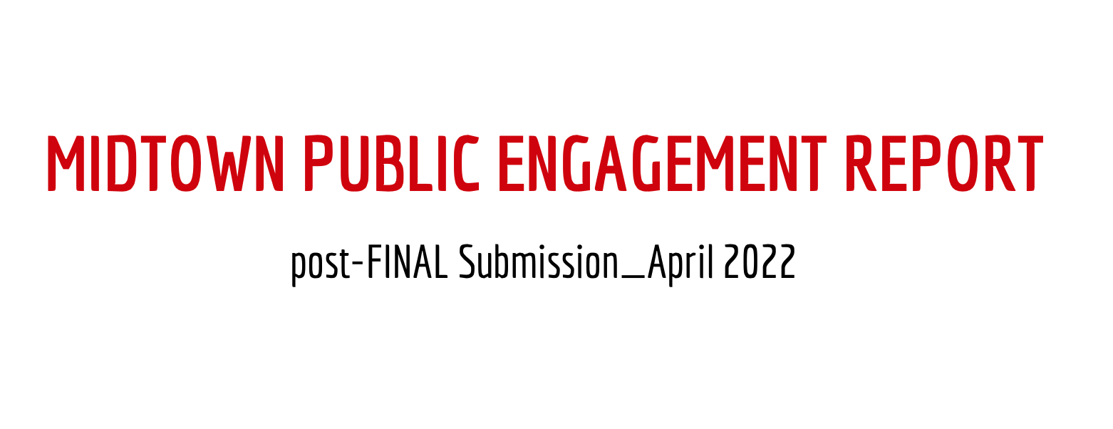
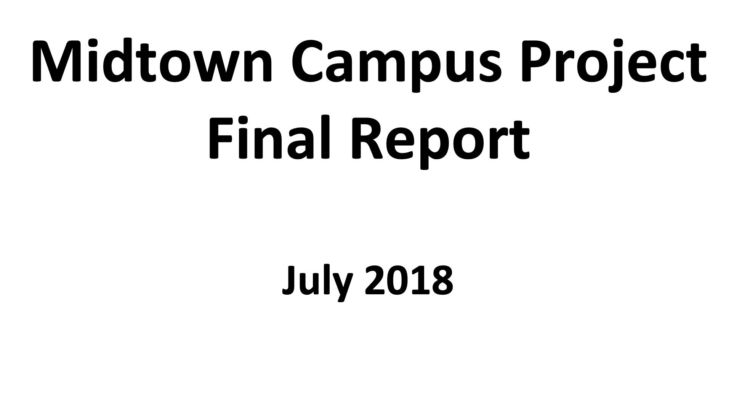
Public Engagement Reports supported by the City of Santa Fe
Midtown Engagement Partners
Various FY22 Activities and Insight
FEEDBACK AND EDUCATION
PUBLIC HEARINGS
&
COMMUNITY PLANNING STIPEND PROGRAM
More information on website: www.MidtownDistrictSantaFe.org

Slide 19
MIDTOWN SANTA FE
For Midtown Information
www.MidtownDistrictSantaFe.org

