Slide 1
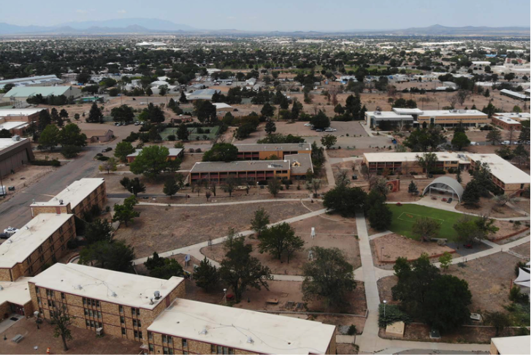
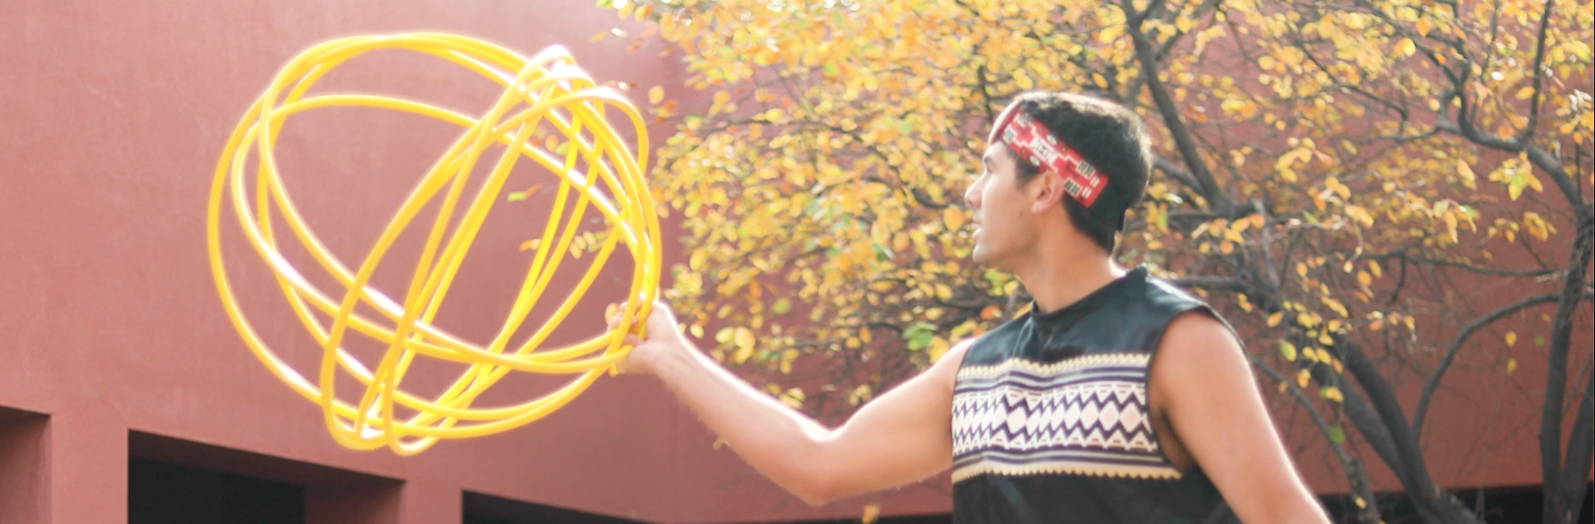
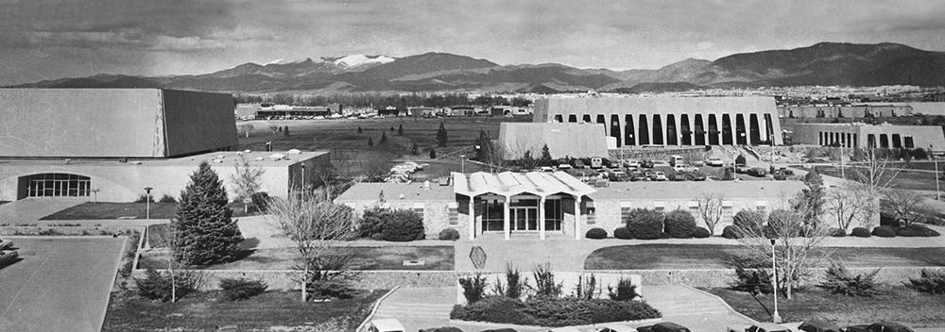

MIDTOWN MOVING FORWARD
Santa Fe, NM
Midtown Redevelopment Plans
Midtown Moving Forward
Progress Report
November 2022

Slide 2
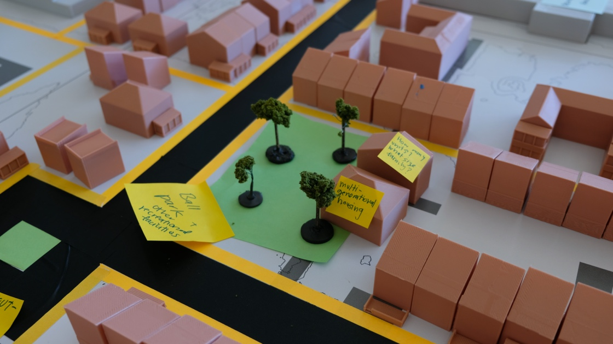
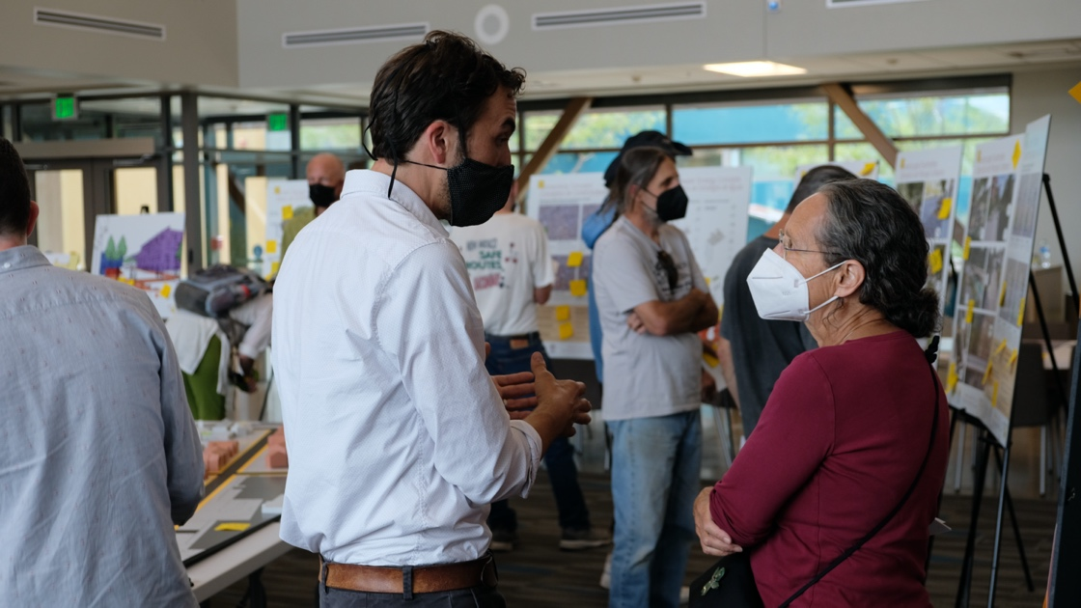
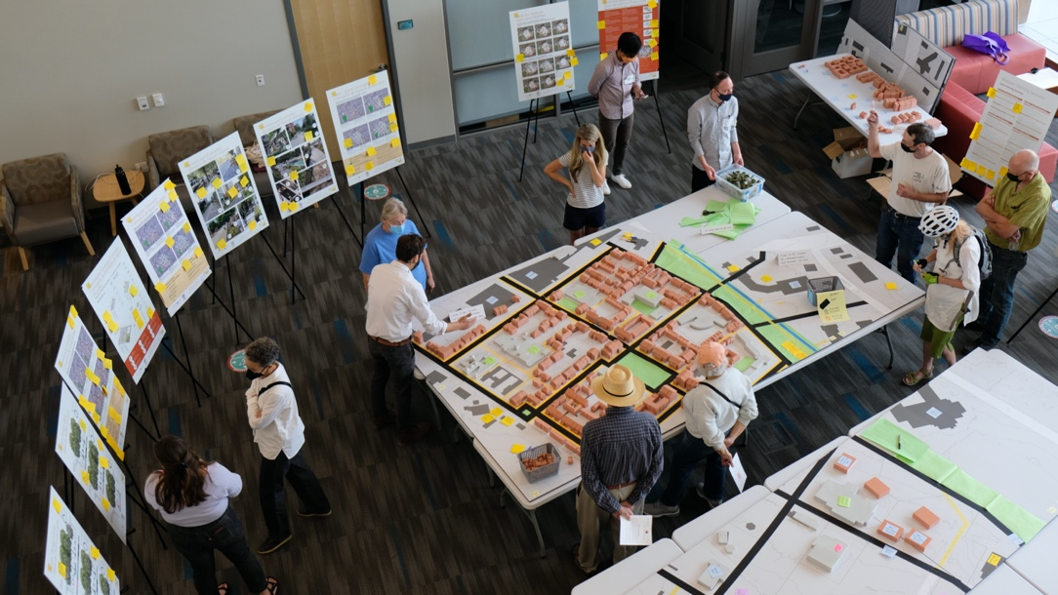
Planning Phases to Date
This plan is the result of community involvement over the past several years and beyond.
2016 LINC Overlay
2018 Midtown Planning Guidelines
2021-2022 Planning Sessions and Midtown Engagement Partners Engagement
2018
Concept Planning
Goals
2021
Designing
Approaches
2022
Refining
Submission
Visioning
Priorities
Approvals

Slide 3
Midtown Moving Forward
Resolution 2022-12 directing City staff to proceed with a list of horizontal development activities
Rezone, Amend the General Plan and Adopt a Master Plan
Community Development Plan
RFP Solicitation for Visual Arts Center
RFP Solicitation for Garson Studios
RFP Solicitation for Garson Performance Theater
Fogelson Library Complex Reuse for a Public Library, Civic Space and Innovation Center
Viability Analysis of Government and Community Services Building on the Midtown Property or Adjacent City-Owned Parcels
Acquire Adjacent Parcels of Land (State-Owned)

Slide 4
Midtown Redevelopment Plans
LAND DEVELOPMENT PLAN
Master Plan – how the land will be developed with buildings, open space, blocks, streets, and infrastructure
Land Use Zoning – what land uses are allowed
LINC Overlay Amendment – acknowledge the unique zoning standard of Midtown within the LINC District
General Plan Amendment – to align the General Plan with the Midtown Master Plan
Based on the US Green Building Council: Leadership for Environmental and Energy Design for Cities and Neighborhood Development
Land Development Plan
Regulates the physical development of the land with design and development standards and requirements
Approvals:
Planning Commission
Governing Body

Slide 5
Midtown Redevelopment Plans
COMMUNITY DEVELOPMENT PLAN
Provides guidance and requirements for developing the site
Is complementary to the Land Development Plan to achieve public policy and community development objectives
Based on the elements of place-based Sustainable Development – Environment, Economy, Equity, Culture
Community Development Plan
Guides community and economic development as plans are implemented
Approvals:
Governing Body

Slide 6
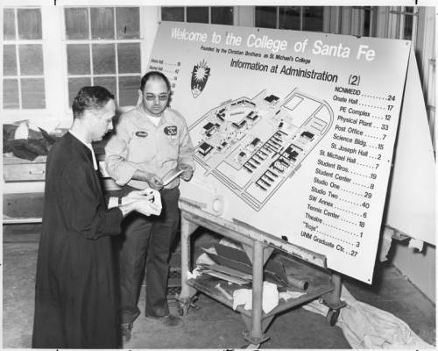
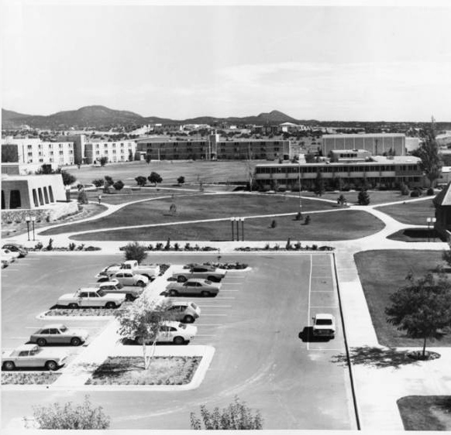
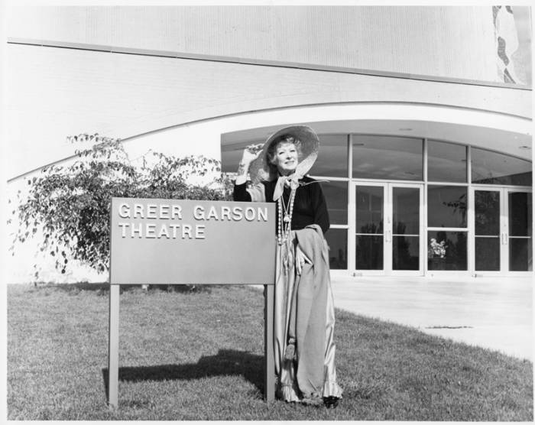
CONTEXT: Midtown District – the geographic center of the city
The Midtown Site has a long history of being a place with uses that benefit the public, including military hospital, and later, educational uses
Notes:
The Midtown Site is geographically located within the urbanized area of the City of Santa Fe on a previously developed site. Site land uses were institutional with limited street networks connected to surrounding areas and infrastructure networks that do not support a mixed-use urban district as directed by the approved Midtown Planning Guidelines (Resolution 2018-54). The Midtown Master Plan promotes sustainable development by facilitating compact mixed-use development, with multimodal mobility and green infrastructure networks.

Slide 7
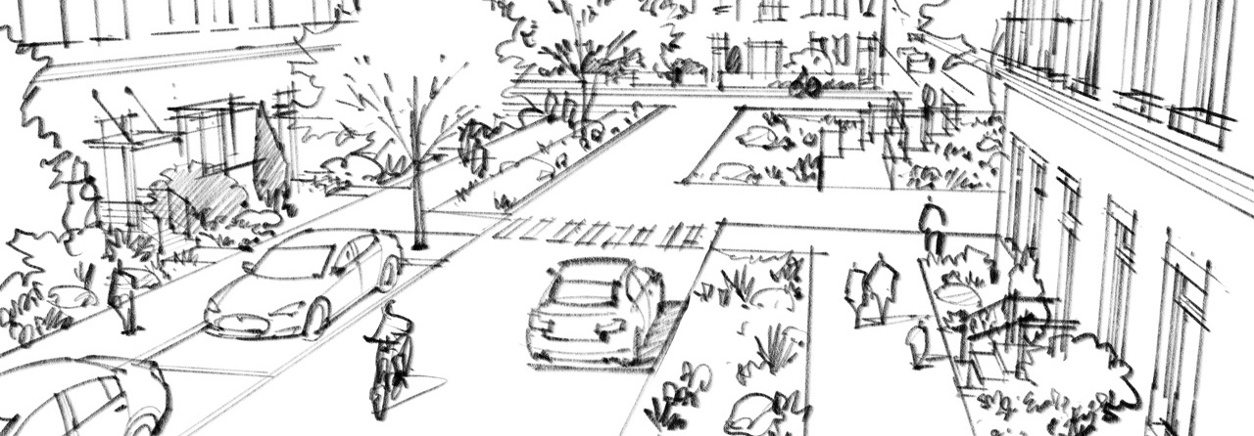

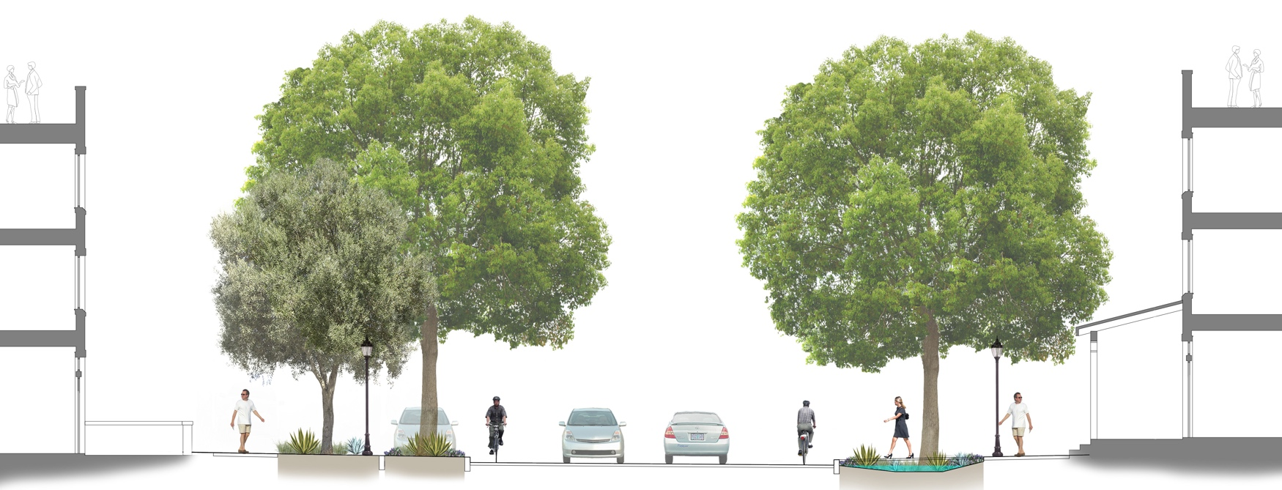
LAND CHARACTERISTICS
Green Streets
Parks & Open Spaces
Design for Health
Notes:
The Midtown Master Plan facilitates development in the center of the City where compact, mixed-use, higher density development reduces development pressures on regional open space important to the natural habitat and hydrological systems. The Midtown Master Plan promotes internal green infrastructure systems that preserve existing trees, use natural slopes, and enhance existing open spaces to effectively manage water and stormwater pressures on adjacent areas and public infrastructure. The Midtown green infrastructure system will work together to filter and infiltrate water to improve the quality of water as it enters the aquifer.
The Master Plan includes:

Slide 8
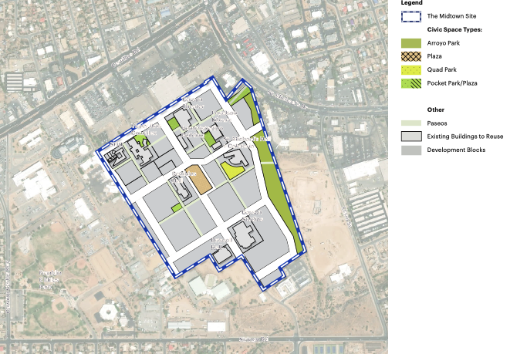
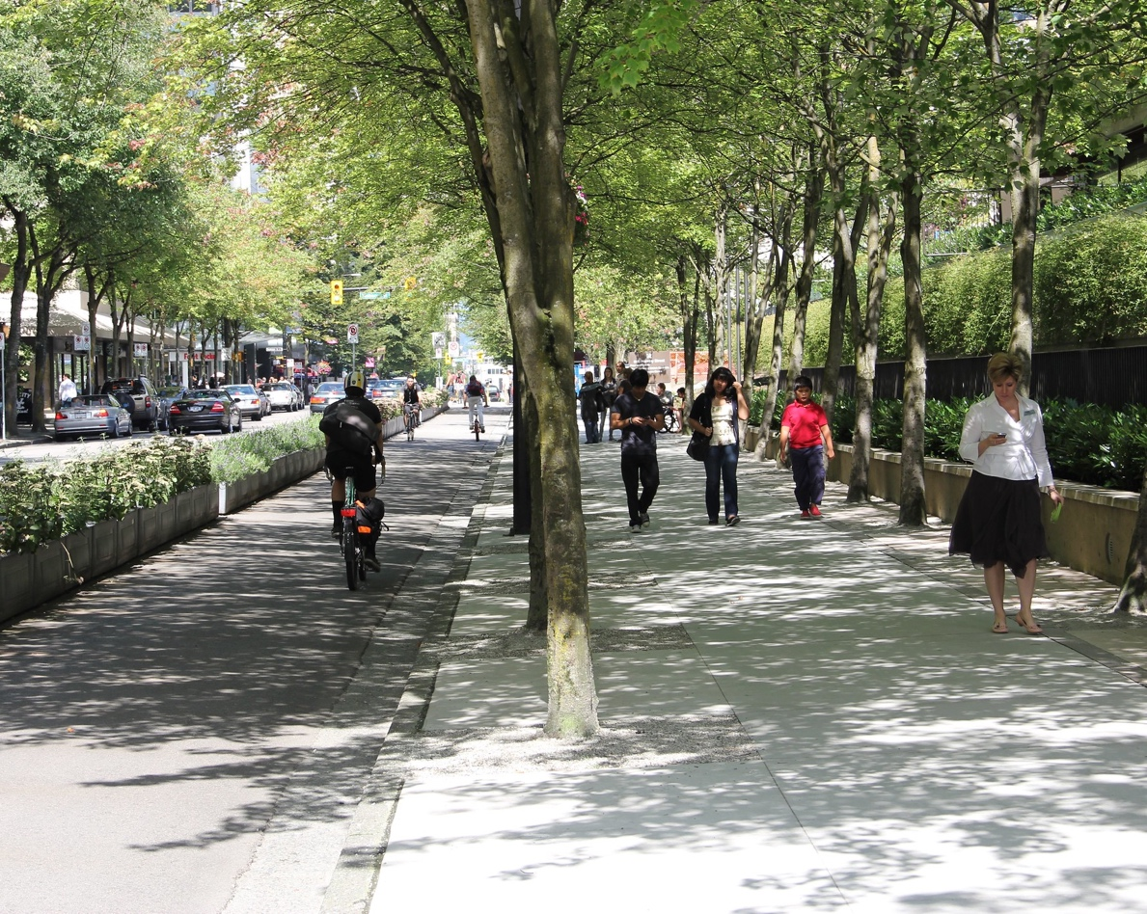
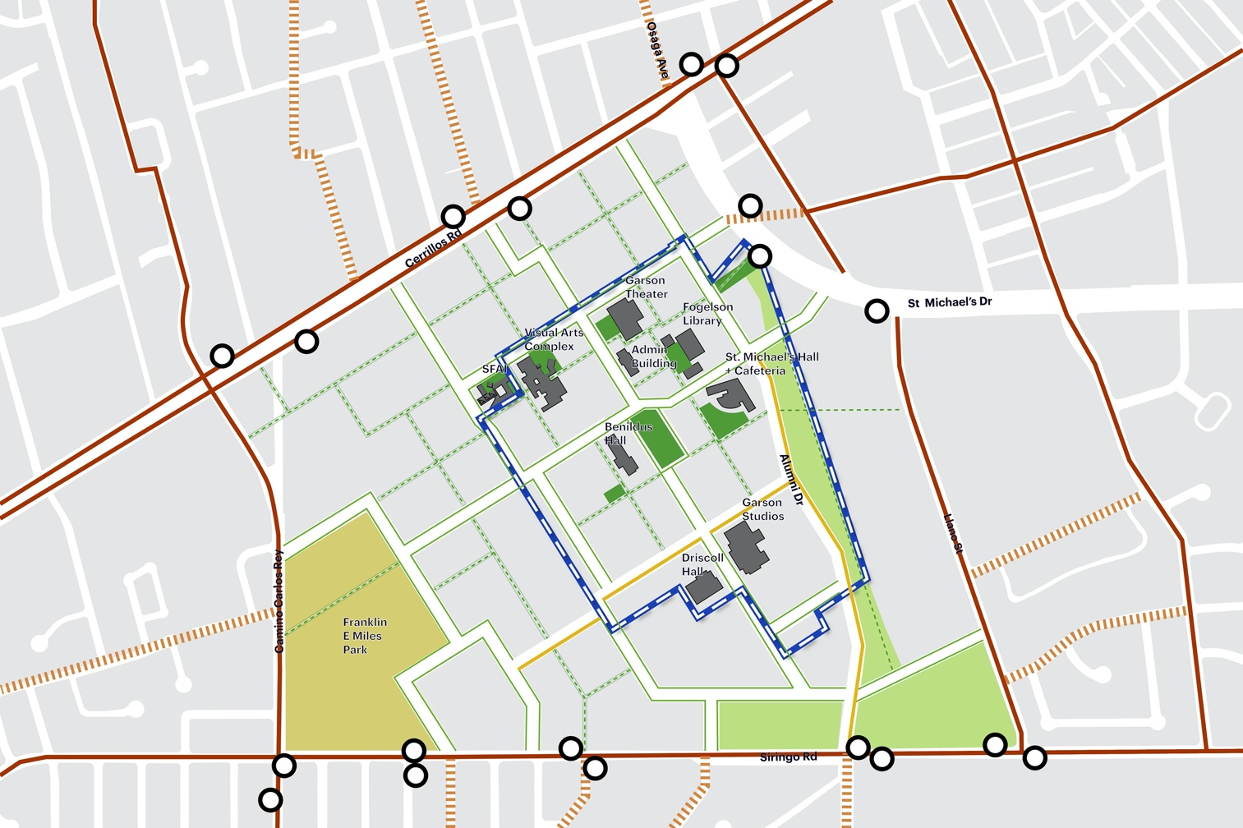

MOBILITY: Design for Walking, Biking and Health
Bicycle and Pedestrian Friendly
Small Block Dimensions
Access to Transit Facilities
Access to Diverse Uses
Universal Design
Notes:
The Midtown Master Plan qualifies as a LEED Compact and Complete Center (CCC) in the geographic center of the city. A CCC is identified as a center within a ½ mile walking distance of an area containing mixed uses, public transit availability, density, and walkability.

Slide 9
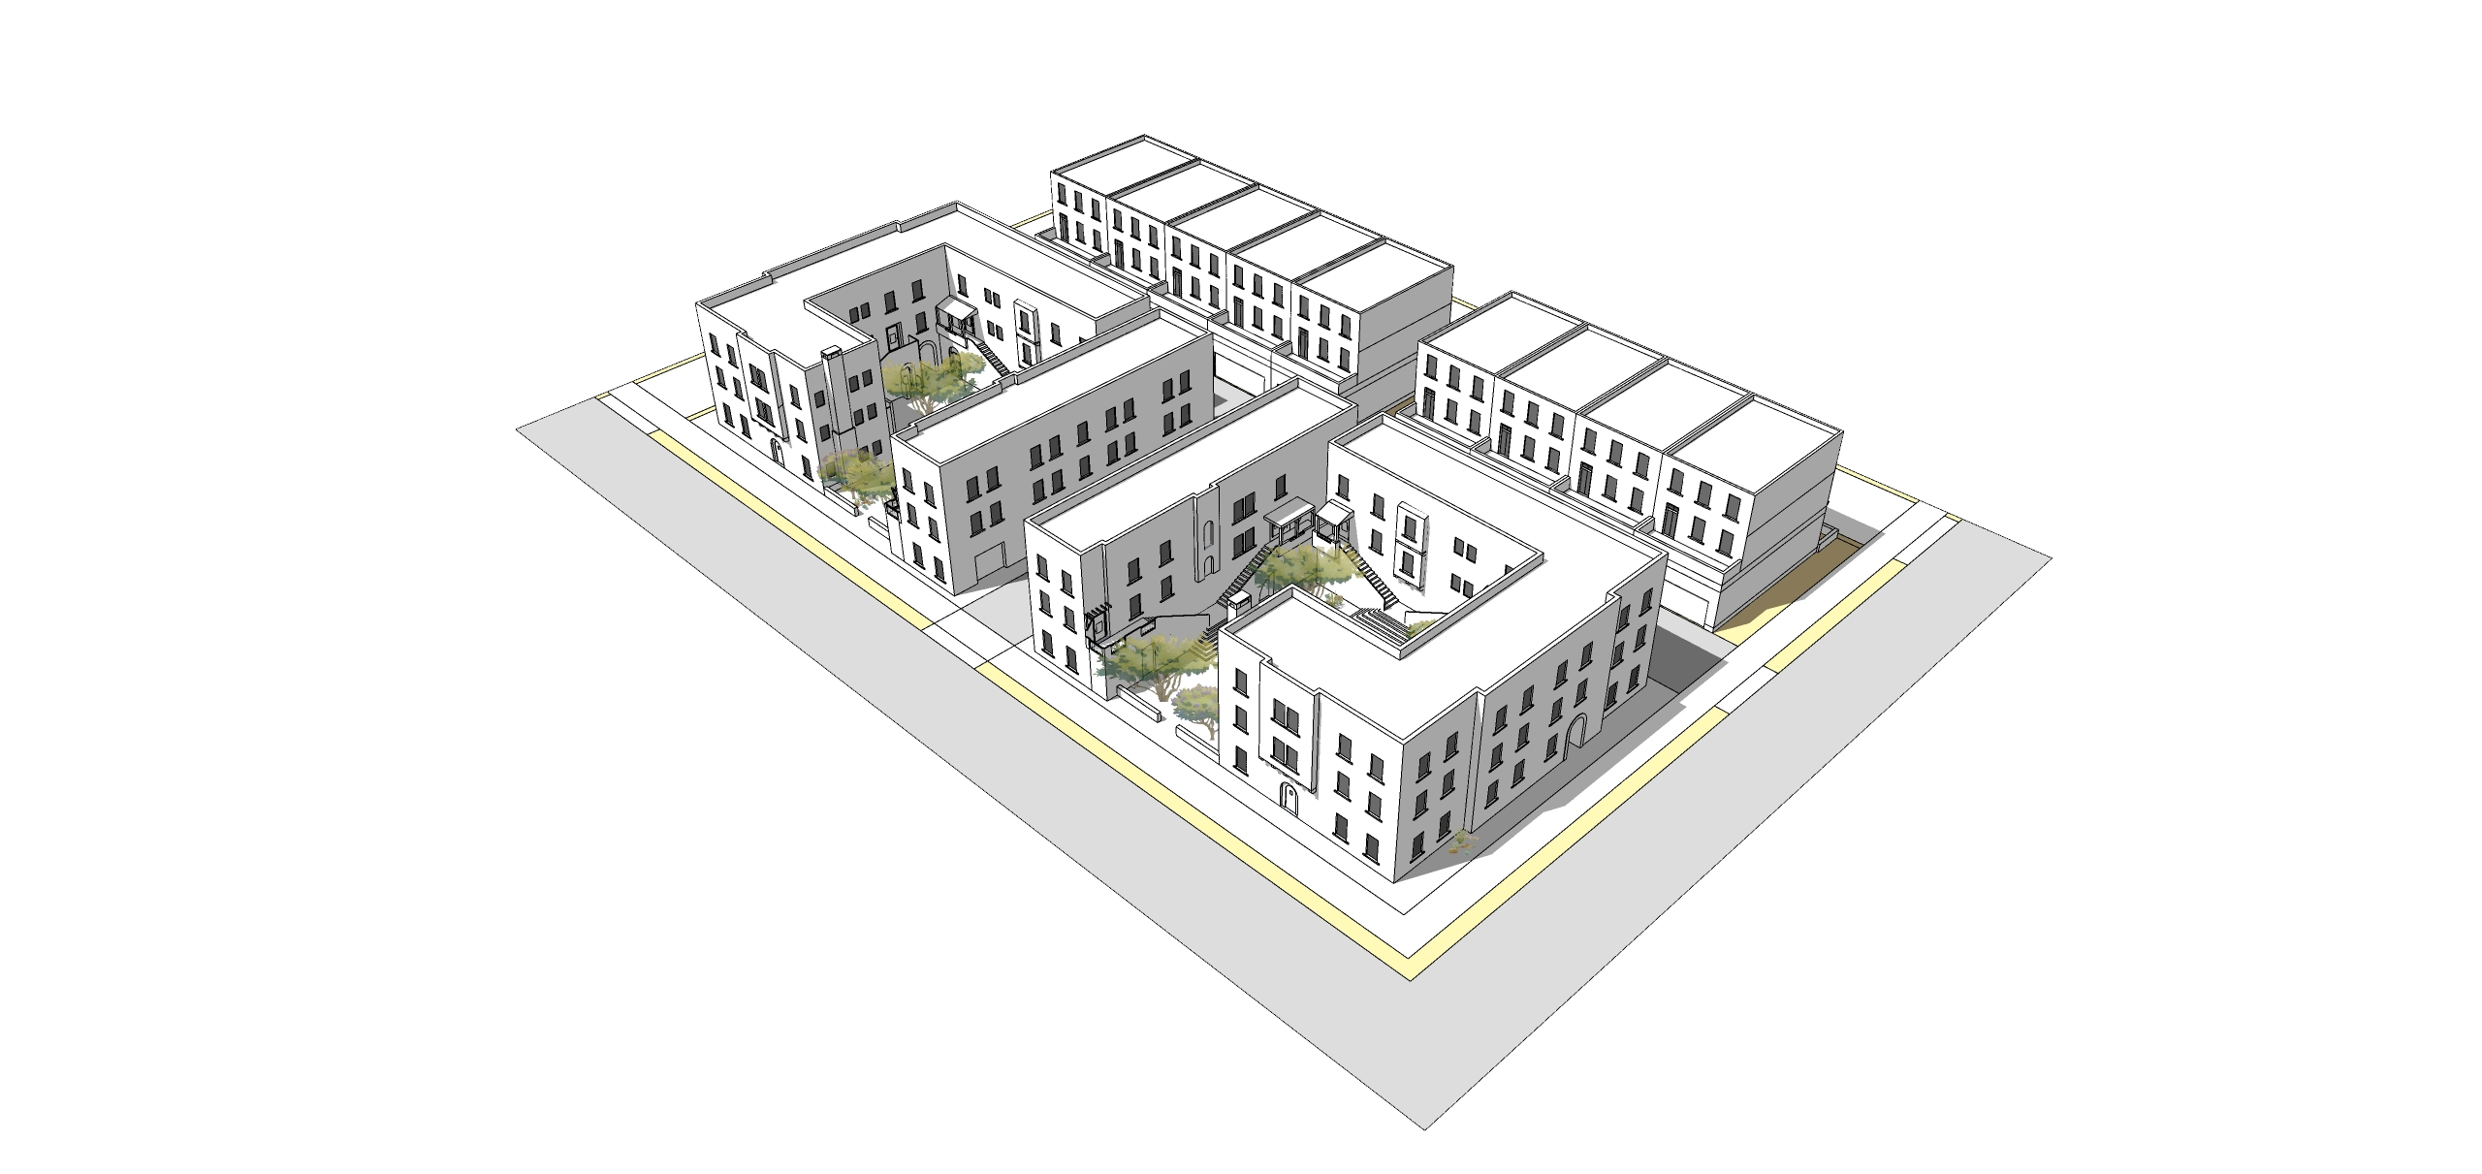
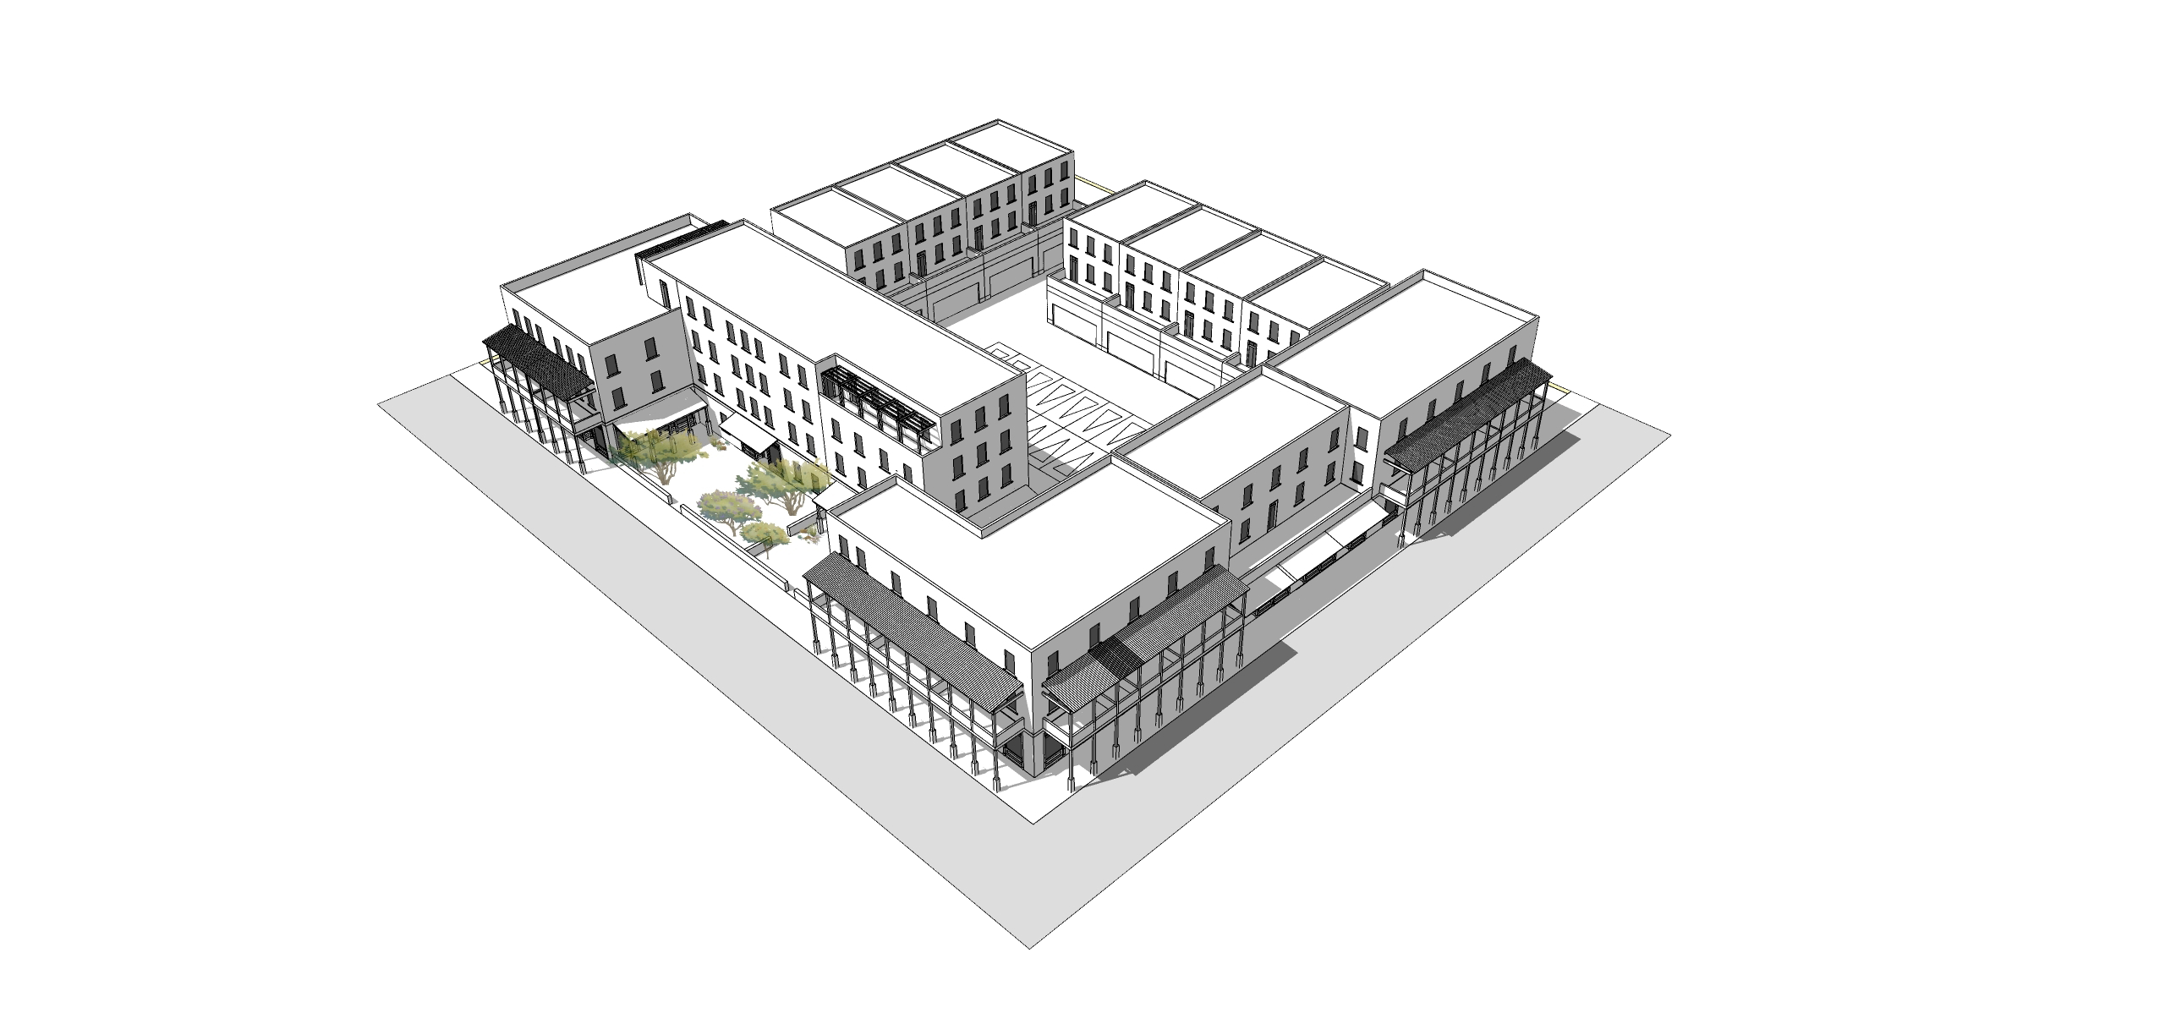
HOUSING AFFORDABILITY / Housing Choices
Inclusionary Zoning for Housing Affordability
Parcels for 100% Affordable Housing Development
Diverse Tenures
Live/Work Units
Expand Housing Choices
Townhouses + Live/Work along pedestrian paseos
Courtyard Apartments and Mixed-Use Buildings along streets
Notes:
The Midtown Master Plan promotes socially equitable neighborhoods by enabling residents from a wide range of economic levels, household sizes, household types, and age groups to live in the district and city using the following strategies.
Inclusionary Zoning for Housing Affordability. All residential development will meet the existing City Inclusionary Zoning for Housing Affordability Requirements.
100% Affordable Housing Development. In addition to the Inclusionary Zoning, the Midtown Master Plan identifies certain parcels for the development of 100% affordable housing development.
Diverse Tenures. Residential development will encourage a mix of affordable and market-rate tenures, including ownership, rental, and land trust.
Diverse Housing Typologies. Residential development will focus on housing diversity within various types of multi-unit residential structures
Expand City-wide Affordable Housing Options. Affordable housing at Midtown will diversify housing options in the north-central area of the city and create more affordable housing in the south and southwestern areas of the city. The Midtown location better connects housing and jobs with access to multimodal networks that will attract diverse households.

Slide 10
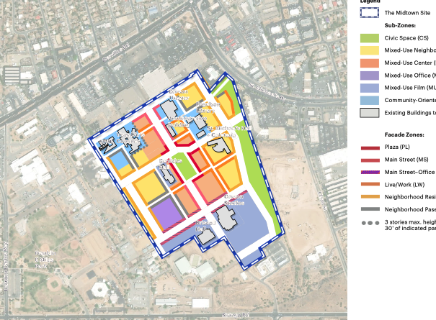
Development Estimates – approximate base calculations for land use planning purposes
Commercial Development (estimated)
Retail/Restaurant: 44,000 SF
Institutional: 128, 160 SF
Office: 90,000-100,000 SF
Hospitality/Lodging: 100 rooms
Film Expansion Lot: 10.46 acres
Notes:
For master planning purposes some calculations were established to determine the amount of non-residential (commercial) and residential development could occur. These are base calculations that create an urban development pattern with various building uses, massing, and typologies.

Slide 11
Development Estimates – approximate base calculations for land use planning purposes
Residential Development
Estimated Total Homes: 1,100 Maximum
Baseline: 30% of total will be affordable to moderate and low-income households
Total Open Space: 6.4 Acres
Plaza: 1.22 acres
Parks & Green Infrastructure: 5.18 acre
Notes:
These are projected total number of residential units based on density patterns for typical multi-family buildings, such as townhomes, multistory buildings, and live/work units. The affordable housing calculation is based on a project ted number of units developed under the inclusionary housing requirement and a set-aside in the master plan for four parcels dedicated to 100% affordable housing developments. Again, these are base calculations. Other public policy objectives regarding affordability can be incorporated into City RFP solicitations and competitively evaluated based on feasibility and ability of a project to achieve affordability goals.

Slide 12
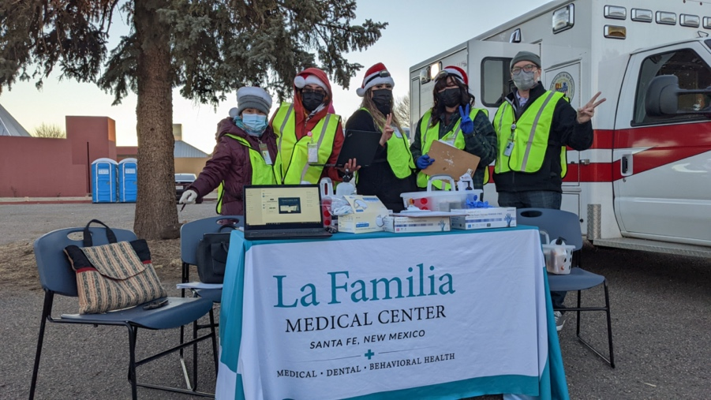
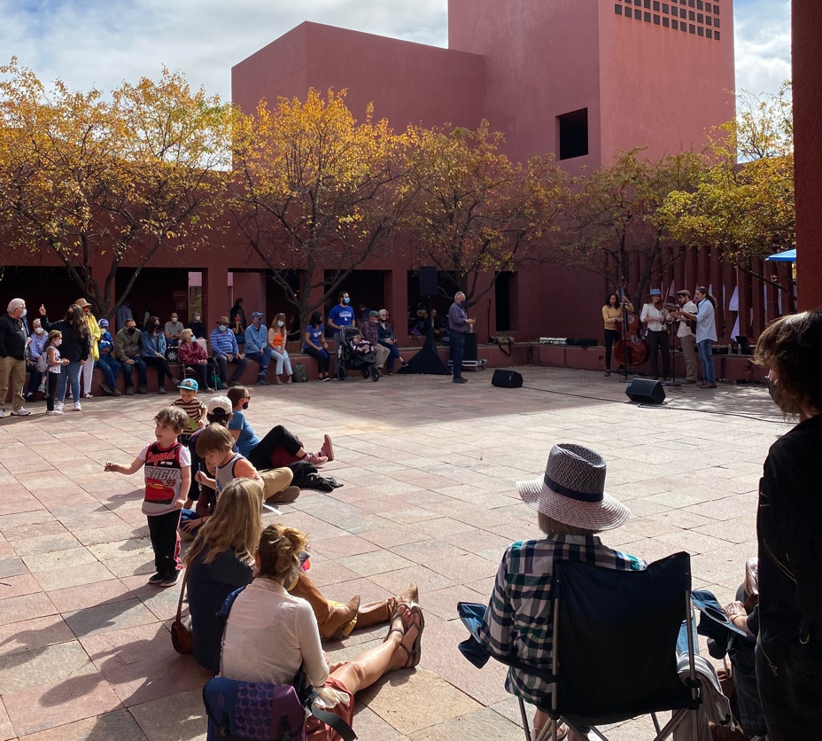
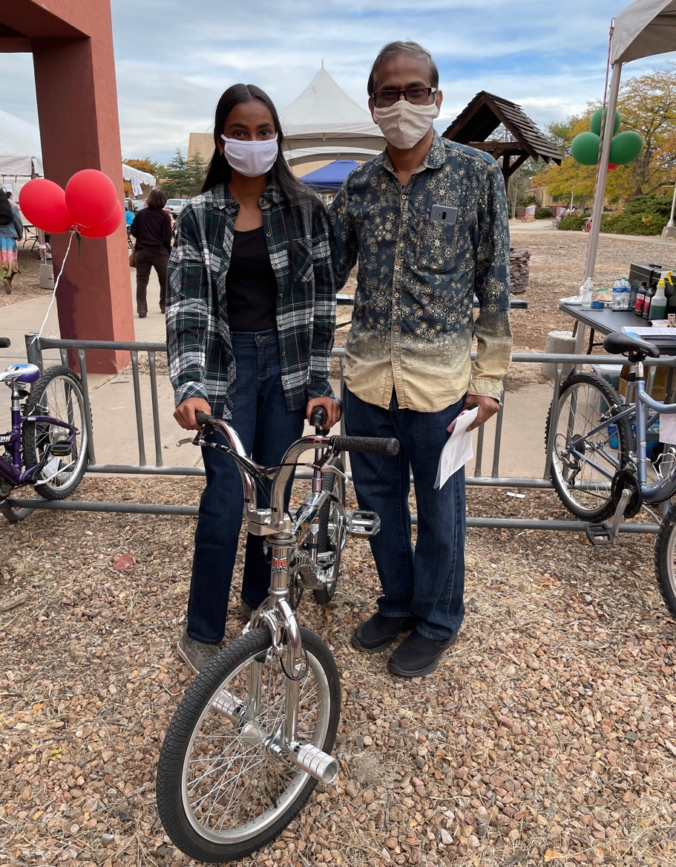
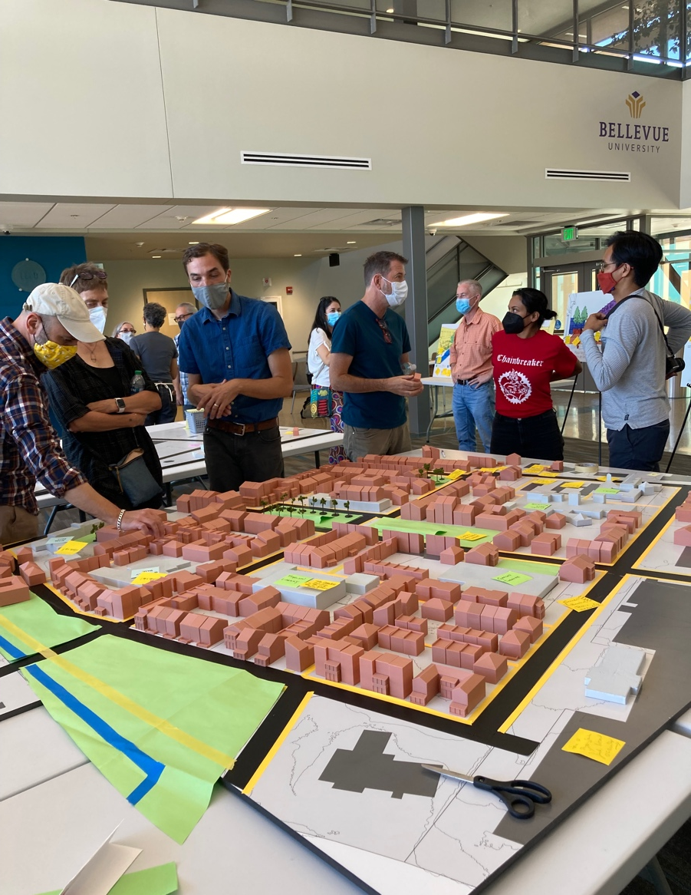
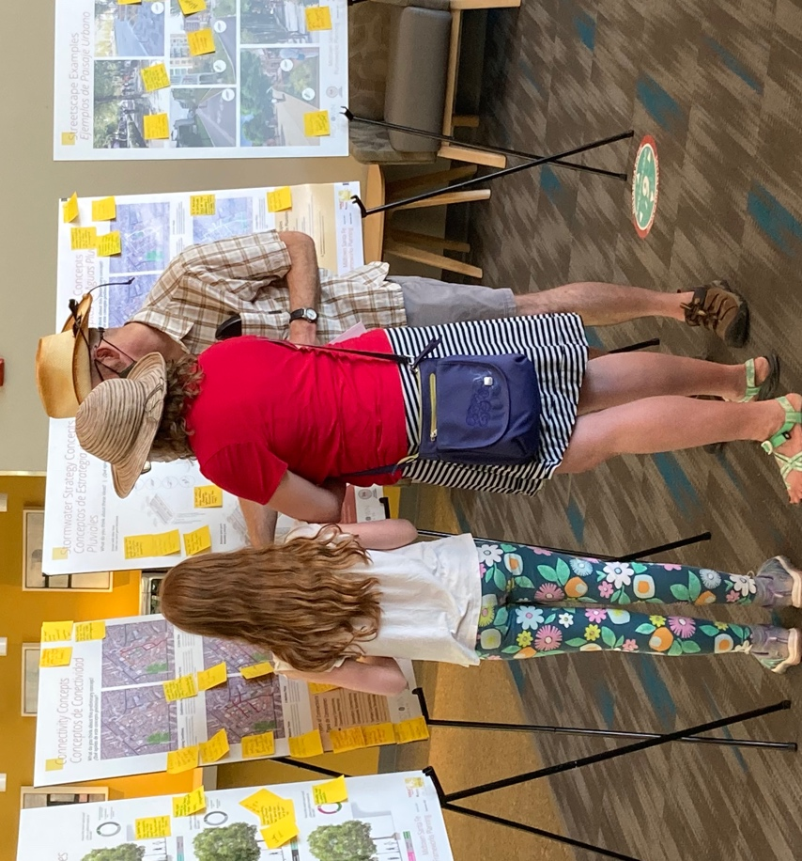
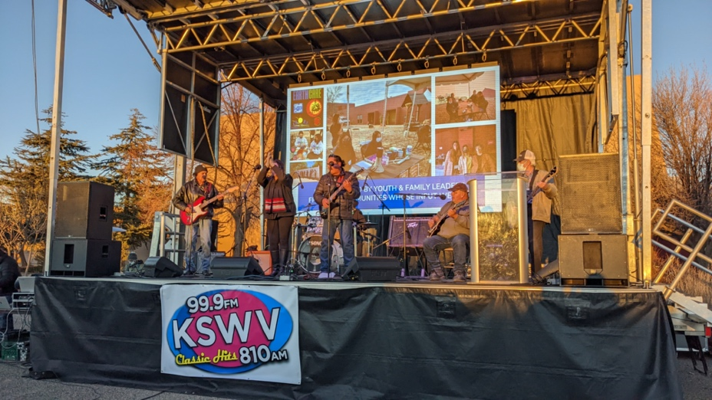
Midtown Public Engagement
ONGOING ENGAGEMENT
Midtown Campus Project (2018)
Midtown Public Engagement Partners (2021-2022)
Community Planning Stipend Program (Jul-Oct 2022)

Slide 13
Land and Development Economics
3-Part Series:
What are the costs, community benefits, and projected rate of return as Midtown Moves Forward?
October 3, 2022 – Midtown Today: The Current Financial Status
October 17, 2022 – Midtown Tomorrow: Costs for Midtown Redevelopment and Management
November 28, 2022 – Midtown and the City’s Return on Investment (ROI): Public Policy and Community Benefits (date change from Oct-31)
Dates subject to change at the discretion of the City

Slide 14
What is the timeline and process for approvals?
Land Development Plan
Early Neighborhood Notification: July 14
Land Use Application: August 22
Planning Commission Hearing: October 20
Governing Body Hearing for Approval: November 30
Ongoing Public Engagement
Community Development Plan
Planning Commission Presentation: September 1
Governing Body Presentation: October 12
Governing Body Introduce Plan: November 30
Governing Body Hearing for Approval: December 14
Dates subject to change at the discretion of the City

Slide 15
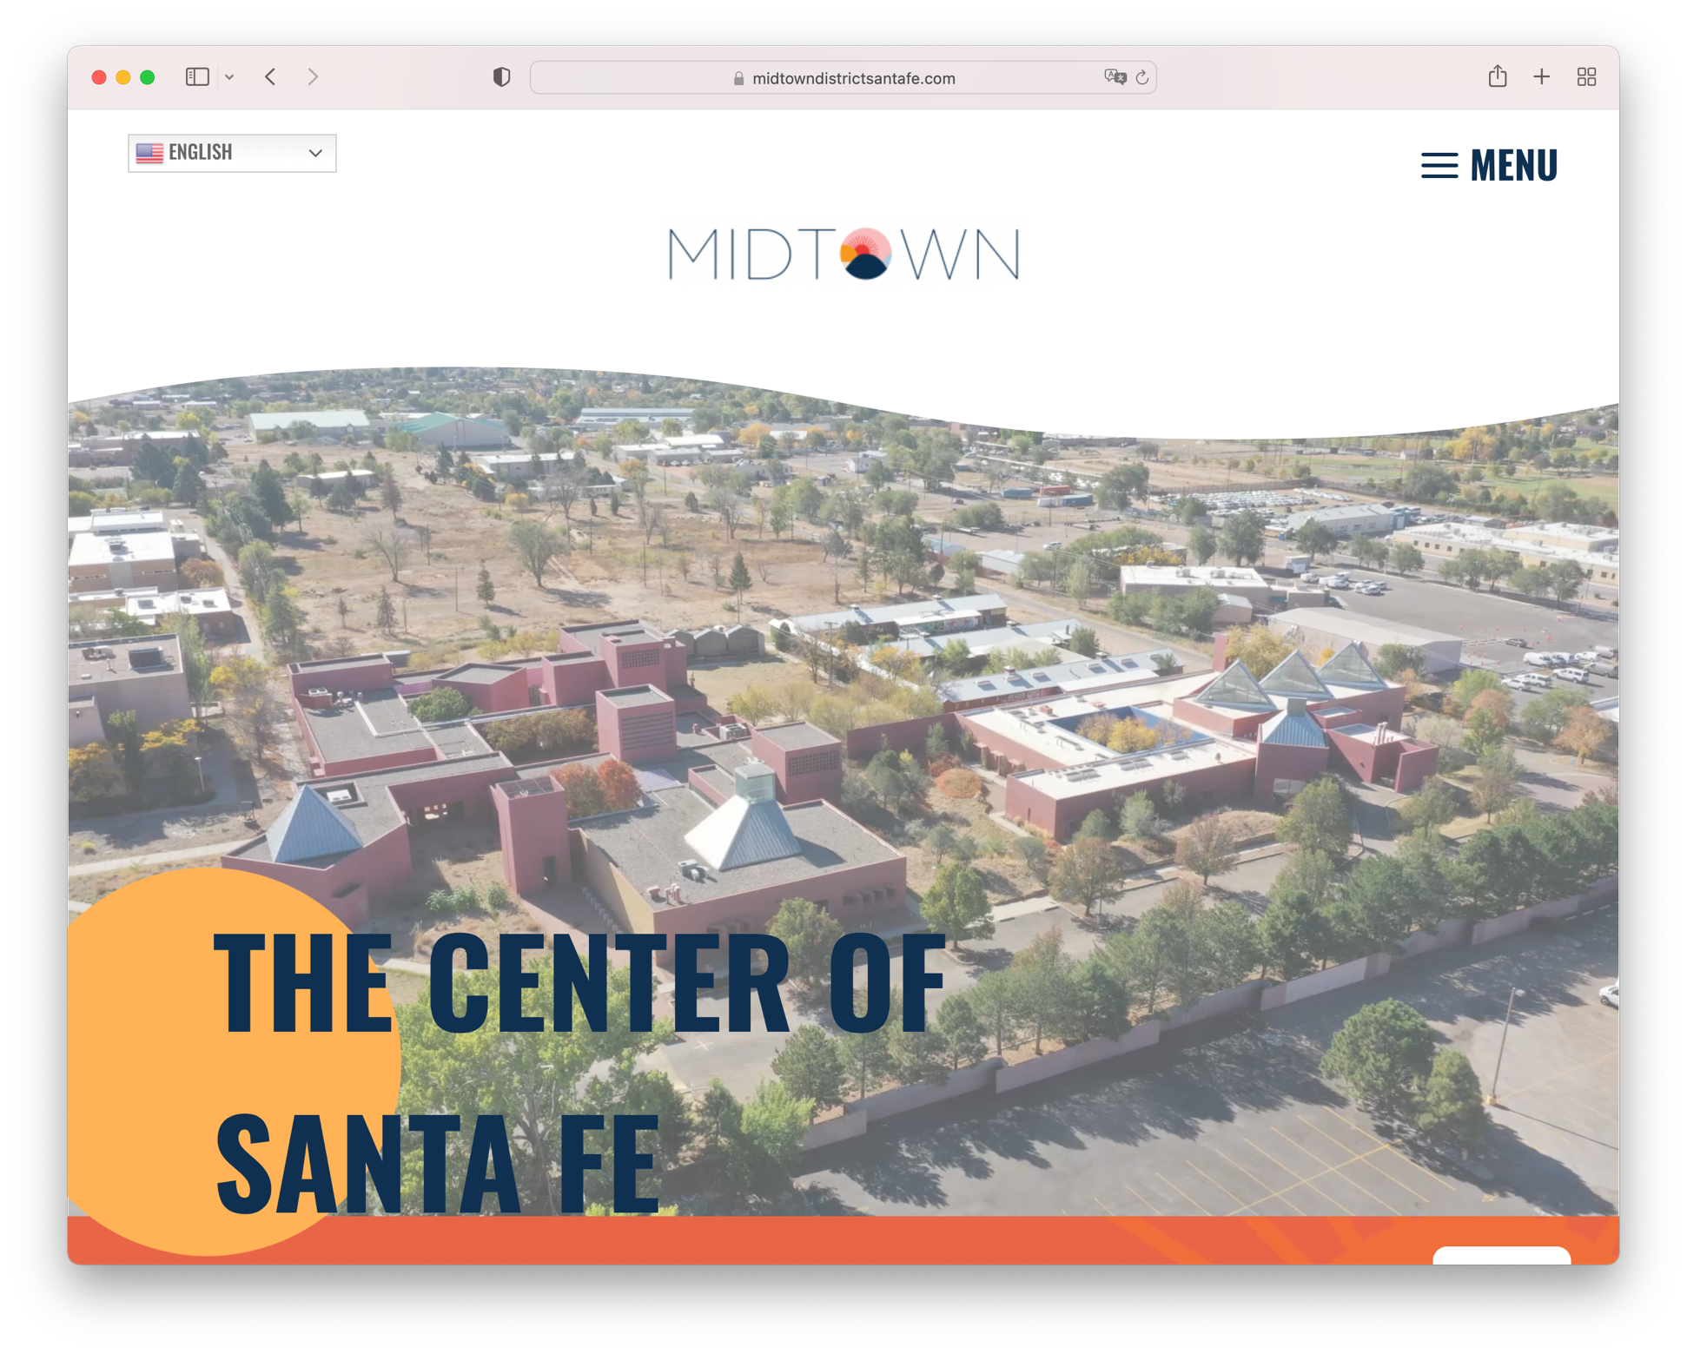
Where can we go to find more information?
GO TO: www.MidtownDistrictSantaFe.org
Get updated information

